Slide 1
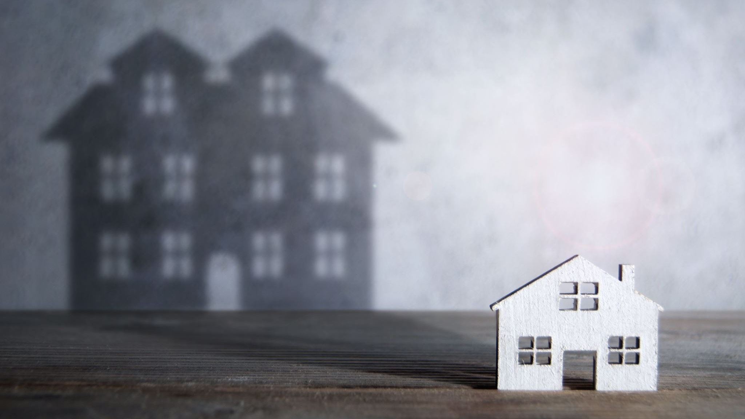
50% ROI in 3 Months Mobile Home Flipping Project

Slide 2
Why Mobile Home?
Right property for the location:
I locate Chilliwack, BC, part of the lower mainland about 200km from Vancouver.
Unlike the bigger city, mobile home is famous in smaller cities like here
Inexpensive and significant to people who are looking to downgrade or for a young family.
Download the file for more information here.
Here are the Pros& Cons: click to download

Slide 3
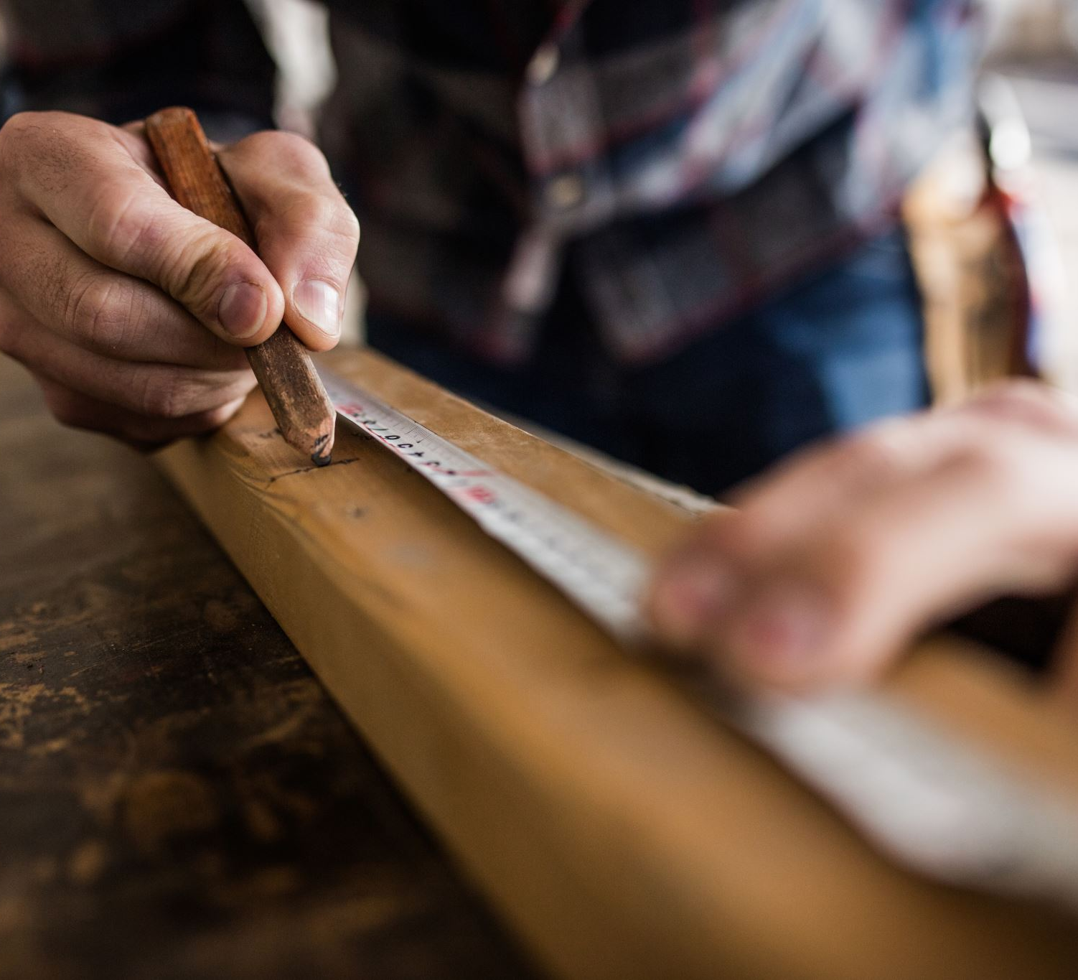
About Me:
My name is Masa. I have been working in residential construction as a journeyman carpenter for over 10 years.
- Instagram
- Website
- Download the file for more information

Slide 4

Research & Analysis:
Mobile park location: 45640 Watson rd. Chilliwack, bc
Data: sales data since 1987

Slide 5
Example last 3 Years:
Purchase Date:
2020-02-06
Purchase Price:
$76,500
Sold Date:
2020-08-16
Sold Price:
$192,000
Purchase Date:
2020-06-25
Purchase Price:
$90,000
Sold Date:
2020-12-07
Sold Price:
$230,000
Purchase Date:
2020-08-20
Purchase Price:
$75,000
Sold Date:
2021-02-16
Sold Price:
$268,900
Purchase Date:
2021-11-12
Purchase Price:
$135,000
Sold Date:
2022-03-02
Sold Price:
$299,900

Slide 6
Analyze Historical Data: Mobile home park: 45640 Watson Rd, Chilliwack, BC

Slide 7

What I see from this data:
I see a price drop after 1994 and 2008 when the number of sales dropped to near zero, but the price trend is consistently upward.
When the number of sales drops this year, we will have a chance to buy a house for lower price.

Slide 8
Another data:

Slide 9

What I see from the data:
Max price, which we know is after the renovation price significantly higher than the minimum price, which we know is before the renovation price.
This data gave me the confidence to purchase a home lower price and sell high price after renovation.

Slide 10
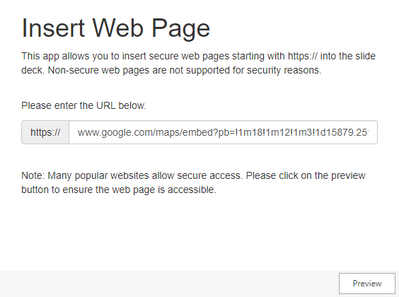
Area Research:
How I feel about the area:
I have been living near the mobile home park that I think it is a great investment place for three years. Lots of development is going into this area and growing rapidly.
The area is new and often people recommend living in this area when you search Facebook or other SNS for newcomers.

Slide 11

Our Target & Cost Forecast:
Target Purchase Price: $110,000
Target Selling Price: $250,000
Anticipated Cost of Renovation: $ 65,000
Anticipated Other Costs: $ 27,800
Target Profit: $ 42,000
Capital Required: $ 83,000
Return on Investment (cash-on-cash): 50.67%
ROI Calculation tool Download: More details in this tool

Slide 12
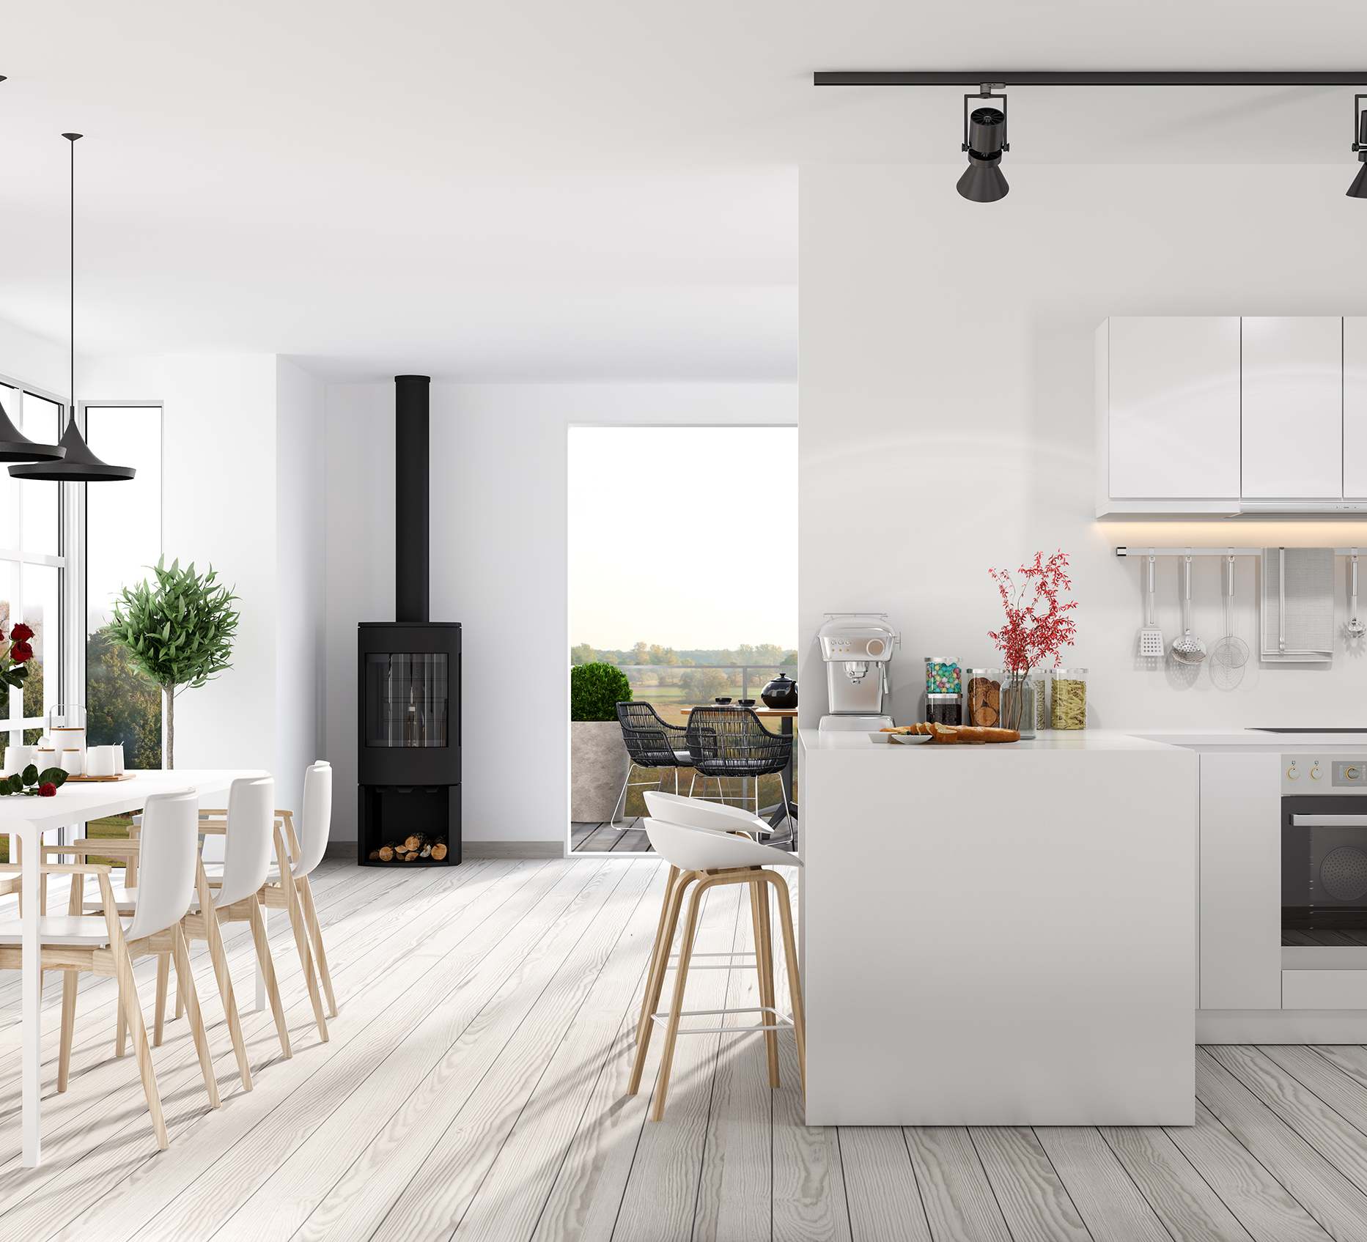
Renovation Plan & Ideas:
Update inside a wall to get today’s building standard. E.g. plumbing, electrical, HVAC and insulation.
Use inexpensive materials with the best care and quality workmanship.
One accent design by using real wood.

Slide 13

Target Audience & Marketing Ideas:
Target Audience:
Young families looking for a starter home at an affordable price.
Marketing Idea:
Share the process with future homeowners. Download here for more info. – not done yet

Slide 14

Risks, challenges, and solutions:
Like any other investment, there are several risks and challenges for this plan.
I share with you the known risks and challenges from my experiences and solutions that I think to prevent or solve those problems. Please look at more details form here:

Slide 15
More Details: Conclusion

Slide 16

Future Business Plan & Partnership:
Mobile home is the starting point. Low cost and more straightforward renovation than a regular house. I want to build up the renovation team and move on to more expensive homes or more complicated renovation projects to make a more significant profit.

